Slide 1
Online laptop shopping
Tejashvi Patel (2091776)
Hiral Bhatt (2091583)
Dilpreet Kaur (2091416)
Nehal Patel (2091632)
Gurkaranbir Hundal (2091618)

Slide 2
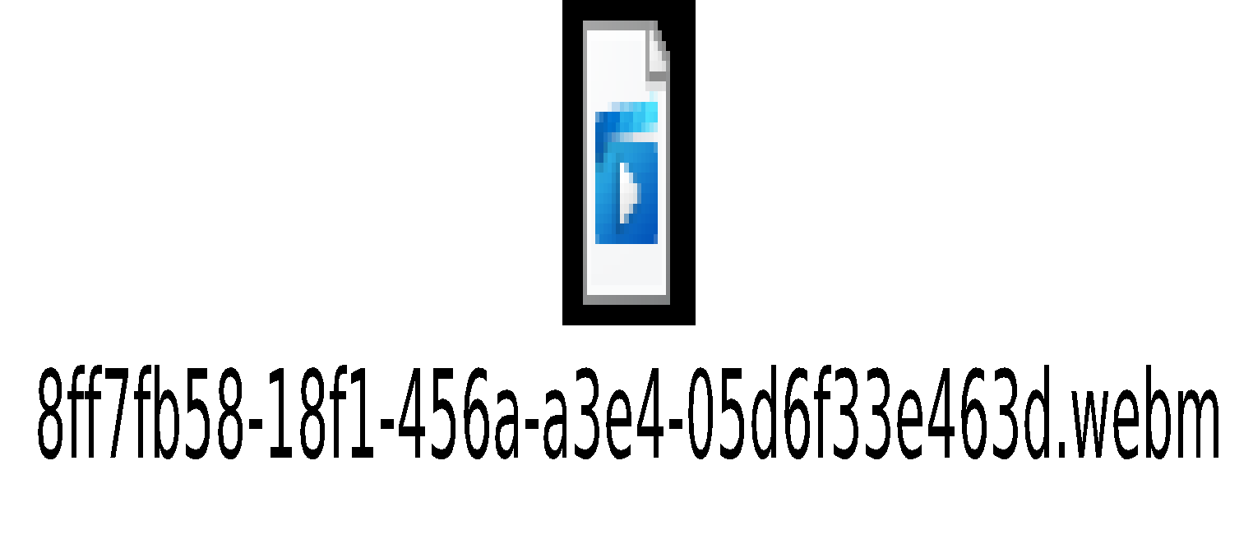
INTRODUCTION
Languages we have used:
HTML
CSS
Javascript
Link:

Slide 3
Firebase
The Firebase Realtime Database is a database hosted in the cloud.
In our project, we have connected the information of Login page and Registration page with Firebase.
Link:

Slide 4
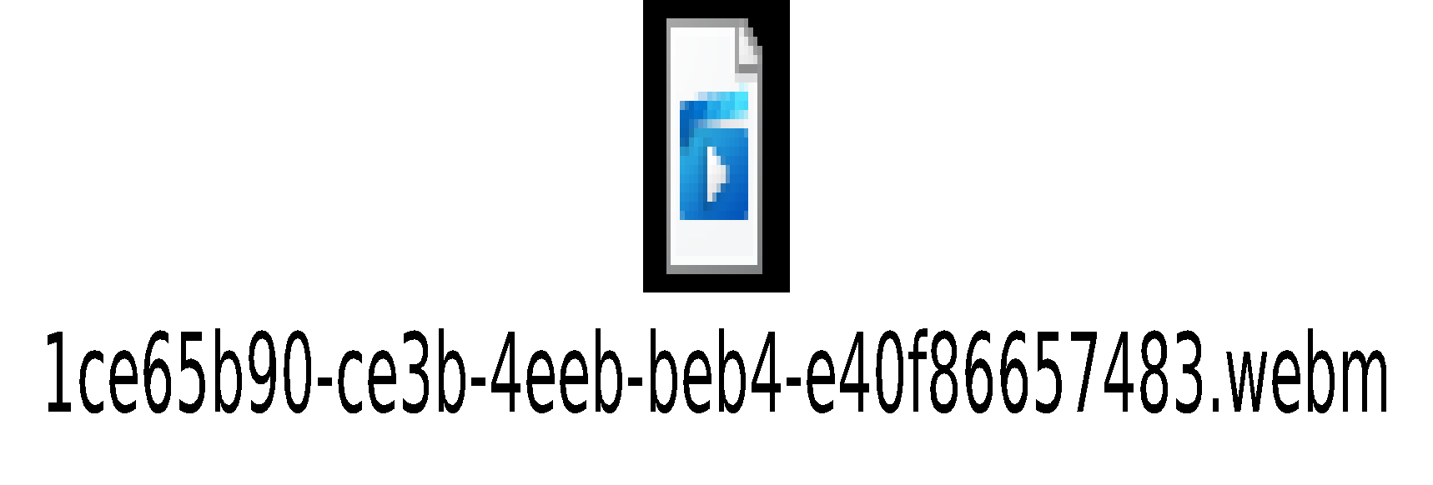
Selenium
Selenium is a portable framework for testing website. Without learning a test scripting language, Selenium offers a replay platform for compiling data validation.
So, we have tested the Login page and Registration page information in Selenium .
Link:

Slide 5

Test Cases
Log in Functional Test Cases
Sign up TEST CASES
CONTACT US TEST CASES
PRODUCT TEST CASES
Link:

Slide 6
Documentation

